Slide 1


ShineOn
A real-time visual tracker for drones.
Pascal Gallo,
Nicolas Malpiece,
Ahmed Rebai,
Dhaouadi Zohra
April 19, 2019

Slide 2
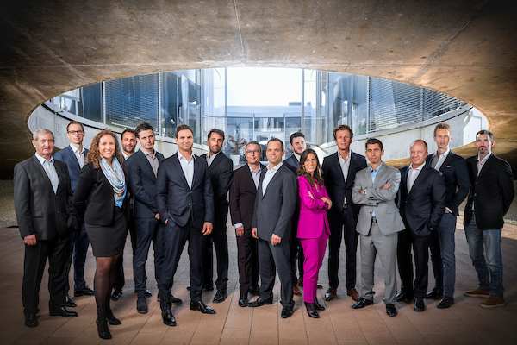
Company Highlights
Company was founded in 2015
EPFL Spin-off
25 employees in 2019
We produce high-quality CVD diamond
We develop diamond-based products
© 2018 LakeDiamond Confidential

Slide 3
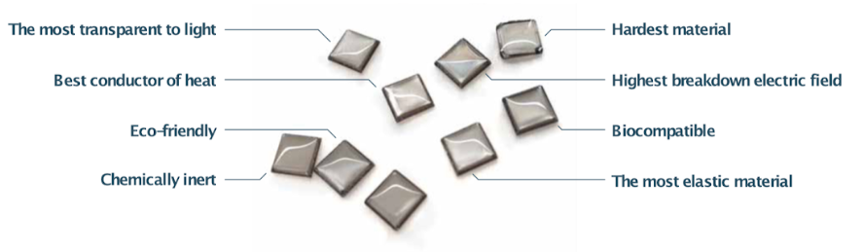
Why diamond?
Notes:
Transparent
conducteur thermique

Slide 4
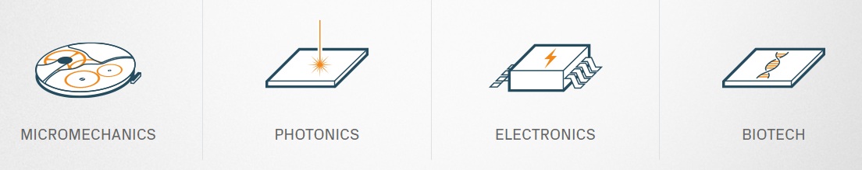
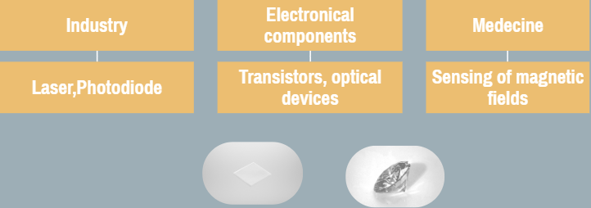
Measure experties
© 2018 LakeDiamond Confidential
Notes:
Different application de type... interest in powerbeaming laser

Slide 5
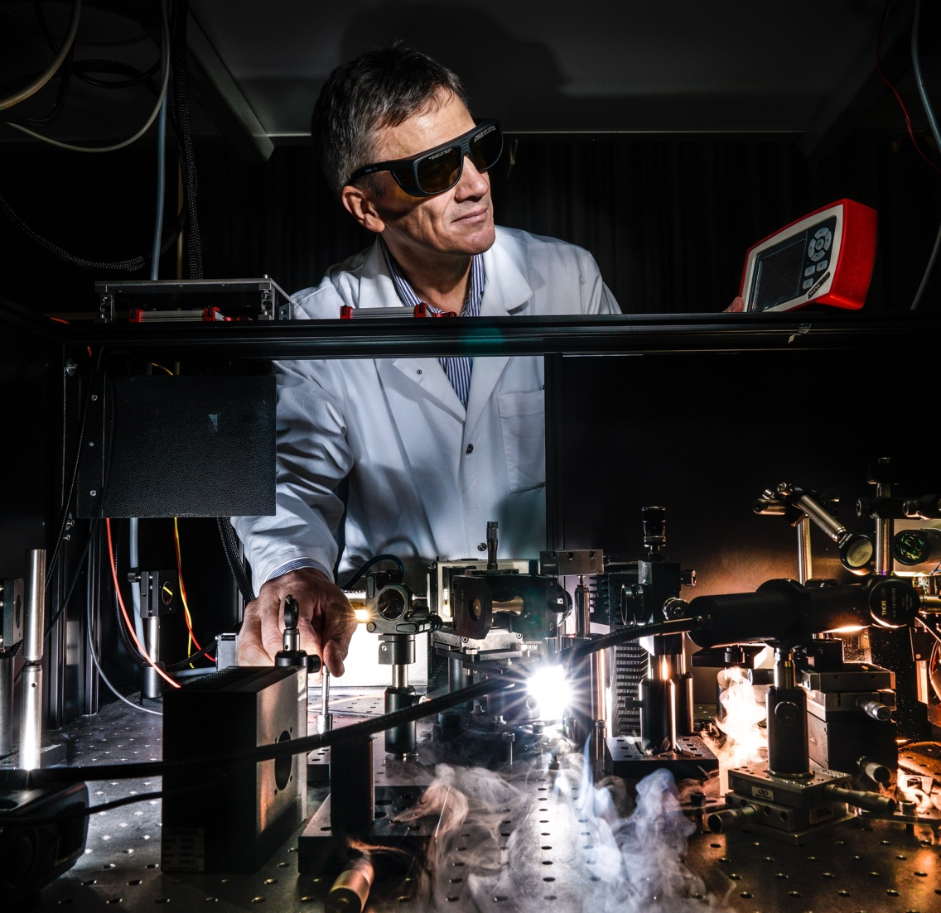
Applications
Our laser activity is a spin-off from EPFL
We build up on 20 years of research on VCSELs and VECSELs
Our expertise is focused on
Research and development
Process industrialization
Long wavelength for telecommunications
High-power
© 2018 LakeDiamond Confidential

Slide 6


Applications
Applications
Power beaming
Drones
Planes
Satellites
Telecommunications
Ground - Ground
Ground - Satellite
Satellite - Satellite
© 2018 LakeDiamond Confidential

Slide 7
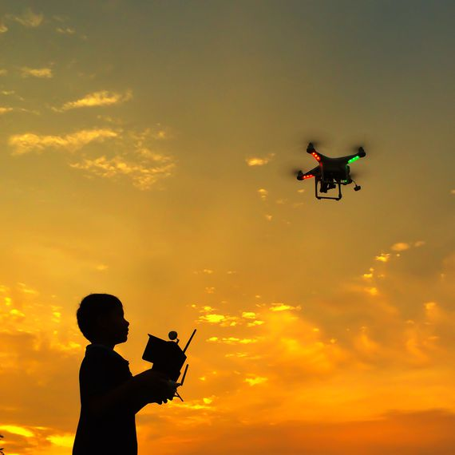
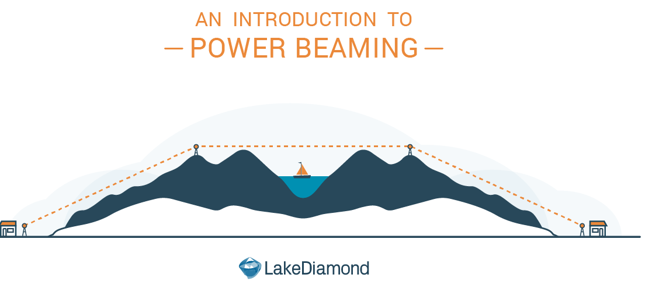

Diamond-enhanced optical devices
© 2018 LakeDiamond Confidential

Slide 8
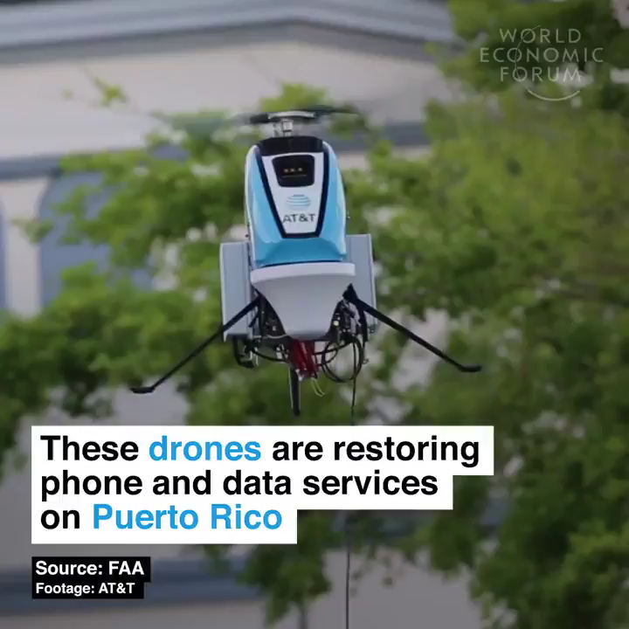
Competitor on the market
Currently on the market, only with a cable
Our advantage
Wireless
Freedom of movement
Operating during the loading phase
© 2018 LakeDiamond Confidential

Slide 9

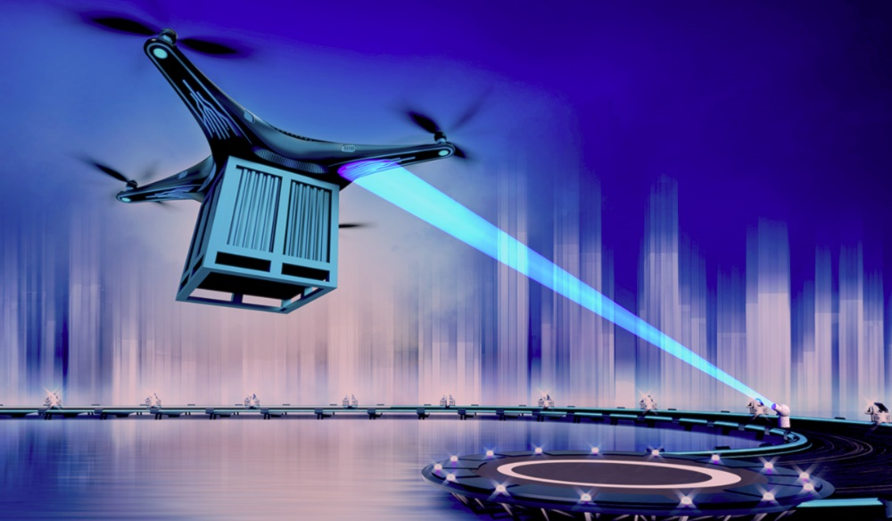
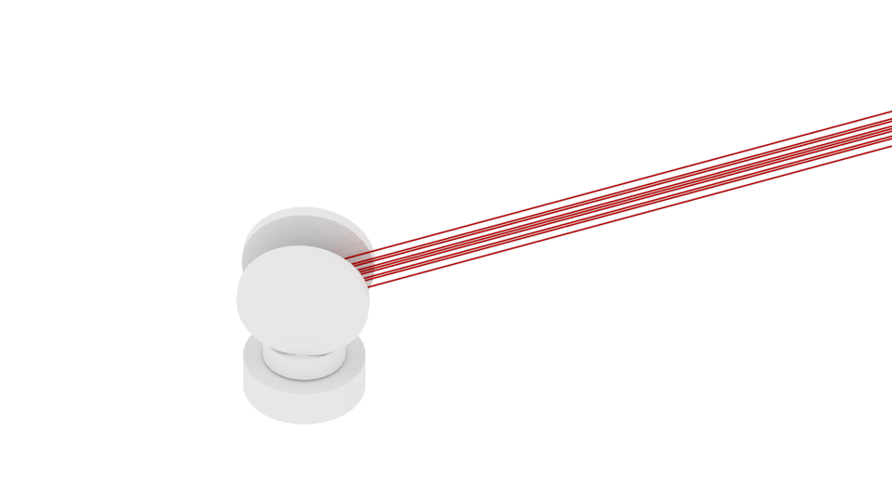
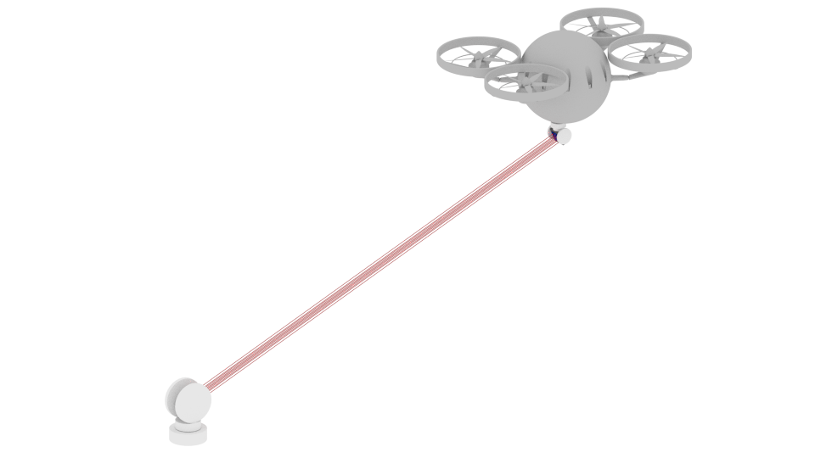
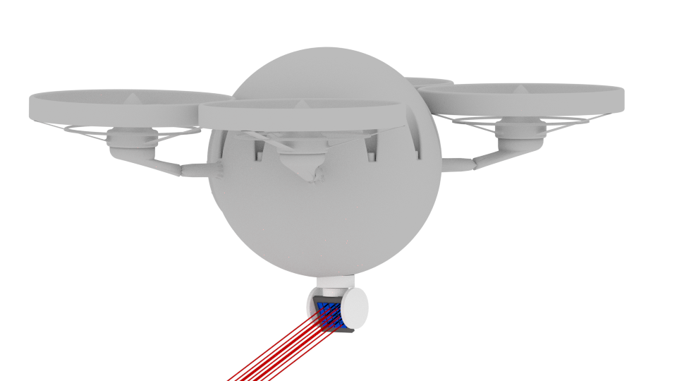
System integration for energy transmission
Power beaming
Array of lasers mounted on tracking system
Range 1m – 1km
Photovoltaic cell mounted on tracking system
Two components :
A high power laser mounted on a rotating base
A photovoltaic cell
Diamond Laser
© 2018 LakeDiamond Confidential
Notes:
Photodiode n est pas du diamond mais c est le laser

Slide 10
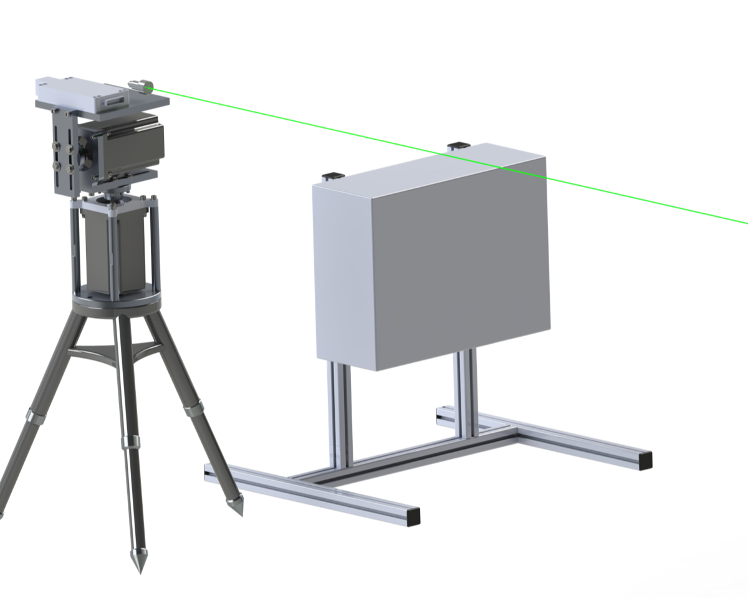
Targeted specifications
Distance
Up to 500m
Real Time tracking:
Gps
Image processing
Photodiode
Electrical Power
From 5W to 300W
Increased power according to development and applications
© 2018 LakeDiamond Confidential

Slide 11
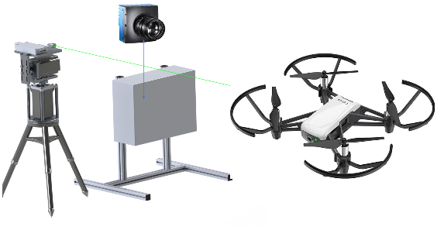
Internship environement
Distance:
1-10m
Real Time tracking:
Image processing sur un intel core i7
Tests:
Under a closed environment
Simple white background
A black uniform color of Tello drone
© 2018 LakeDiamond Confidential

Slide 12
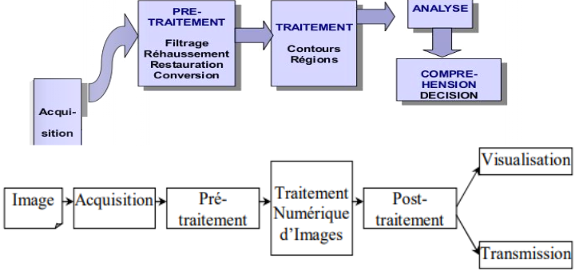
Image processing iterations
Acquisition: capture of the image by camera
Preprocessing: Improve the quality of the picture, format the RGB image with noise correction.
Processing: apply methods for contour detection and image position on a 2D axis
(x, y)
Analysis: the result , the position of the object.
© 2018 LakeDiamond Confidential

Slide 13
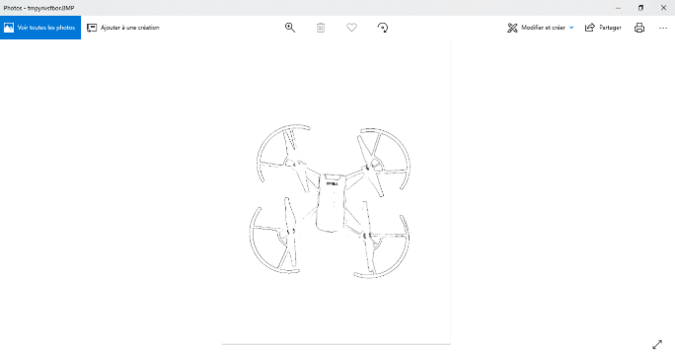
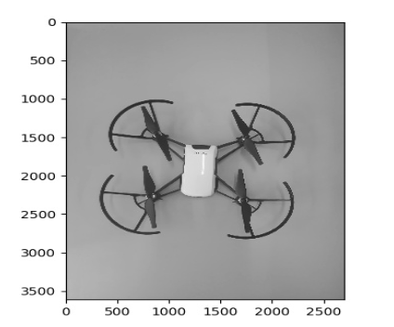
Basic standard iteration in a spectral space
To make the pixels values easier to work with,we always start by converting the drones picture to a gray level.
Contour detection = Erosion - Dilation
© 2018 LakeDiamond Confidential

Slide 14
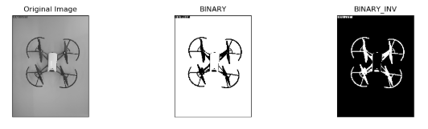
Basic standard iteration in a spectral space
Transform a greyscale image into an image whose pixel values ​​can only be 1 or 0 would make our mathematic operation even more simple!
We then speak of a binary image!
Threshold: Input=GrayImage, Outbut=Binary image
© 2018 LakeDiamond Confidential

Slide 15
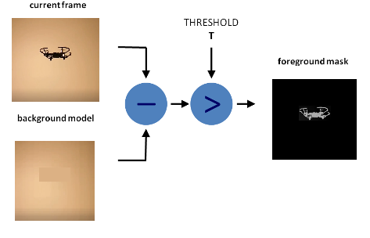
Initialization for drone detection
Drone detection by image subtraction
using Python technology
© 2018 LakeDiamond Confidential

Slide 16
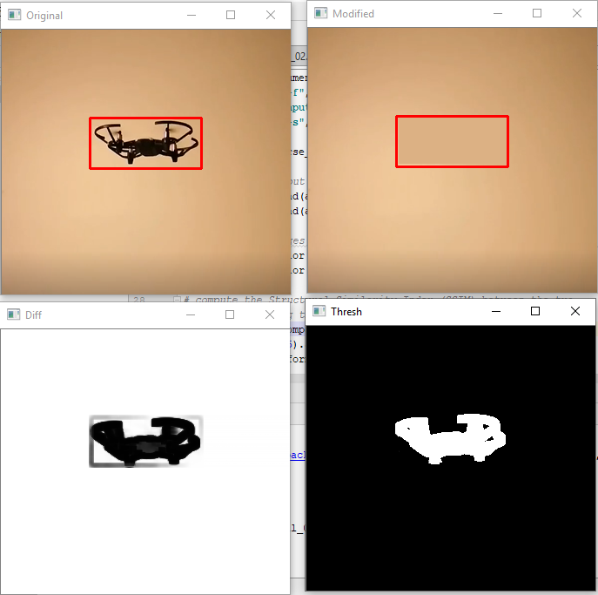
Proposed solutions
Drone detection by frames subtraction
FinalFrame=Frame1-Frame0
© 2018 LakeDiamond Confidential

Slide 17
Mathematic solution
Declaration:
Matrice vide
Matrice niveau de gris
Matrice pour stockage du frame
Matrice de frame finale aprés 5 itérations
Condition: Tout les matrices de meme taille
© 2018 LakeDiamond Confidential

Slide 18
Mathematic solution
Matrice niveau de gris:
Notre video est un ensemble d'image,
Une image est une matrice.
On fait une convertion de notre image en niveau de gris.
50 | 30 | 30
60 | 125 | 20
50 | 130 | 168
On prend le min de la matrice:
MatriceNiveauDeGris.min() = 20
© 2018 LakeDiamond Confidential

Slide 19
Mathematic solution
Matrice initialisé vide = MatriceNiveauDeGris - MatriceNiveauDeGris.min()
30 | 10 | 30
40 | 108 | 0
30 | 110 | 148
MatriceVide.max()= 148
© 2018 LakeDiamond Confidential

Slide 20
Mathematic solution
MatriceVide= (MatriceNiveaDeGris/148)*255
45 | 15 | 45
60 | 163 | 0
45 | 189 | 255
© 2018 LakeDiamond Confidential

Slide 21
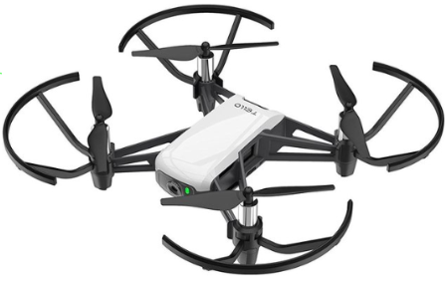
Mathematic solution
MatriceFrameFinal=
MatriceVide-MatriceNiveauGris
-5 | -15 | -5
0 | 37 | 20
-5 | 59 | 75
© 2019 LakeDiamond Confidential

Slide 22
Mathematic solution
On met à zero les valeur negative grace à un masque:
MatriceFinale=ma.masked_array(MatriceFrameFinale, mask=(MatriceFrameFinale > 0))
0 | 0 | 0
0 | 37 | 20
0 | 59 | 75
© 2018 LakeDiamond Confidential

Slide 23
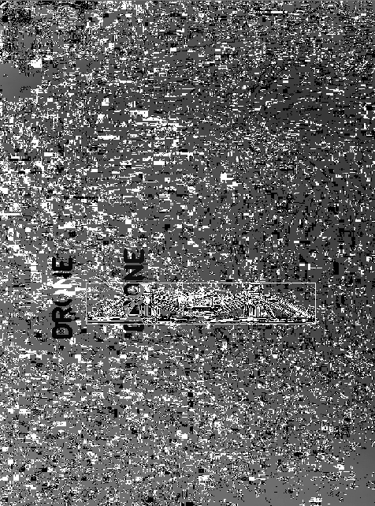
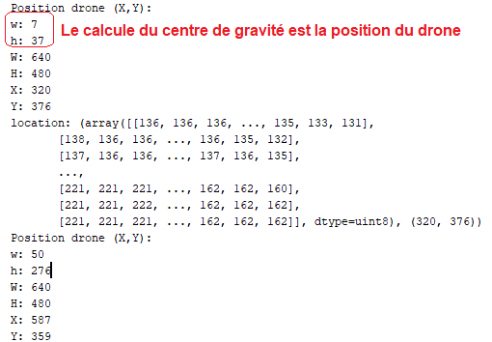
Mathematic solution
Resultat console
© 2018 LakeDiamond Confidential

Slide 24
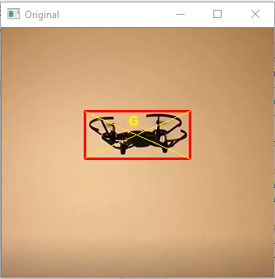
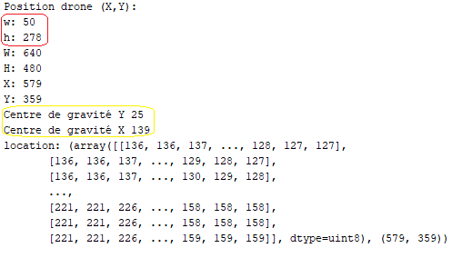
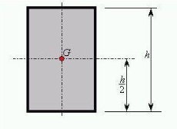
Mathematic solution
Resultat console
© 2018 LakeDiamond Confidential

Slide 25
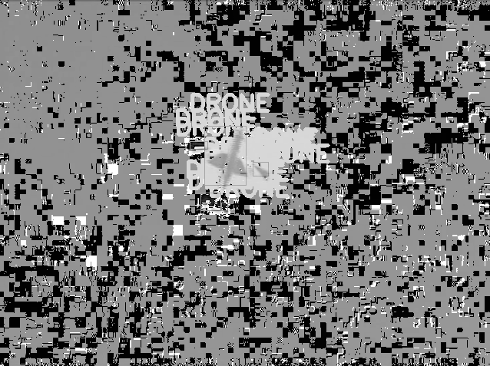
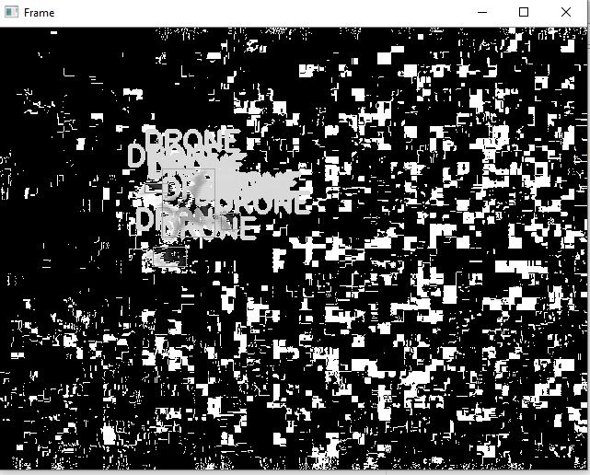
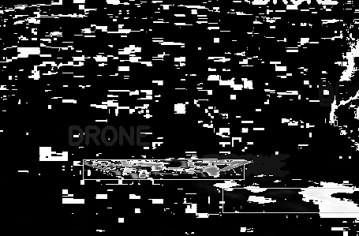
Proposed solutions
Drone detection on gray video
© 2018 LakeDiamond Confidential
Tests under different videos with different drone and backgrounds

Slide 26


Mathematic and technologies justifications
For the mathematic complexe of working in a spatial phase and for the time that could an operation of FFT take we chosed to work on a simple spectral space with binary frames.
For the technologies: We started with the following prototypes using python for its mathematical bibliography: Numpy and computer vision using OpenCV.
Moving to an implementation using C++ for the fact that its the fastest treating our operations.
C++
© 2018 LakeDiamond Confidential

Slide 27
Future objectives
Implementation with API on the tracking platform
feasible an unspecific demonstrator
Code tracking optimization
Optimization of the complete chain system
final deliverable a demonstrator with reliable accuracy for tracking
C++
© 2018 LakeDiamond Confidential

Slide 28

Read about US!
© 2018 LakeDiamond Confidential

Slide 29
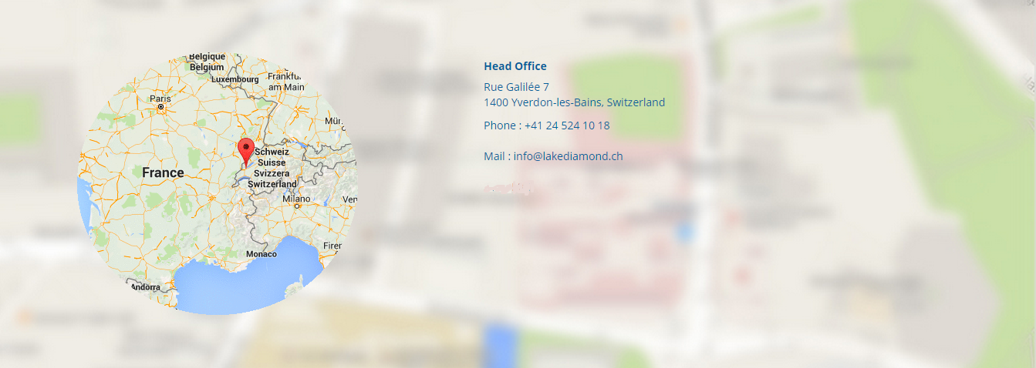
THANK YOU FOR MORE INFORMATION!
Pascal Gallo, CEO
pascal.gallo@lakediamond.ch
Nicolas Malpiece, Project Leader
+41 79 235 34 43
nicolas.malpiece@lakediamond.ch
© 2018 LakeDiamond Confidential

